Slide 1
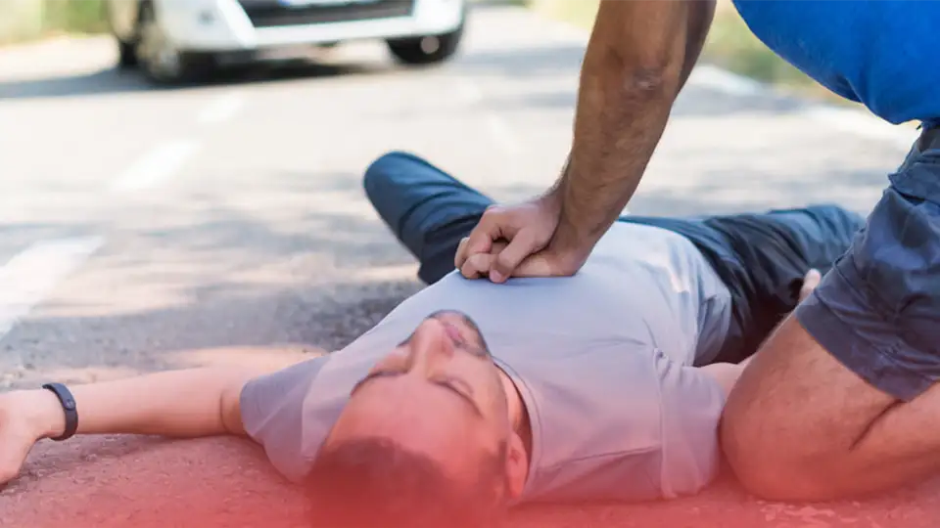
Cardiopulmonary Resuscitation(CPR)

Slide 2
CPR/Rescue Breathing and How Does It Differ from CPR?
CPR stands for cardiopulmonary resuscitation. It can help save a life during cardiac arrest, when the heart stops beating or beats too ineffectively to circulate blood to the brain and other vital organs.
Rescue breathing is a type of first aid that’s given to people who have stopped breathing. During rescue breathing, you blow air into a person’s mouth to supply them with vital oxygen.
Rescue breaths can be given alone when a person has a pulse but isn’t breathing. CPR is done when a person’s heartbeat and breathing have stopped. CPR involves cycles of chest compressions and rescue breathing.

Slide 3
When to Perform CPR
Knowing when to perform Cardiopulmonary Resuscitation is crucial as it is the first line of defense in maintaining blood circulation and oxygenation in someone experiencing a cardiac arrest or respiratory failure.
Breathing and pulse are the two critical factors in determining whether someone needs CPR. If a person isn’t breathing or doesn’t have a pulse, you need to perform CPR immediately. Here are the situations where a victim needs CPR
note: rescue breathing can be given alone when a person has a pulse but isn’t breathing.

Slide 4
7 Key Situations that requires CPR
When someone is unconscious(not awake and aware of and responding to one's environment)
Cardiac arrest :Cardiac arrest occurs when the heart suddenly stops pumping blood effectively. This happens due to various reasons, including a heart attack, arrhythmia, or other heart-related issues.
Choking :Choking is a life-threatening emergency that occurs when an object obstructs the airway, preventing air flow into the lungs. In cases of severe choking, the person becomes unconscious.
Electrocution:Electrocution disrupts the heart's electrical system, leading to cardiac arrest.

Slide 5
Drowning:Drowning is another situation where CPR should be administered promptly. When a person is submerged in water and unable to breathe, their oxygen levels rapidly decrease, which leads to cardiac arrest. After pulling the victim out of the water, it is essential to start CPR if the victim is unresponsive and not breathing.note: Due to the conditions of near-drowning, the American Heart Association recommends that rescuers deliver two rescue breaths first and then begin the cycles of chest compressions and mouth-to-mouth breathing as directed in the CPR guidelines.
Drug Overdose:Drug overdoses, especially opioids like heroin or synthetic opioids, leads to respiratory failure and unconsciousness.
Suffocation:Suffocation occurs due to various reasons, including being trapped in an airtight space or having an object obstruct the airway f someone is found unconscious due to suffocation, start CPR if they are not breathing or do not have a pulse

Slide 6
Steps to Administer CPR
Assess the Situation
Before starting CPR, ensure that the area is safe for you and the victim. Look for any potential dangers or hazards that could harm you or the person in need. If it is safe, proceed to the next step.
2. Check for Responsiveness
Tap the victim’s shoulder and shout, “Are you okay?” to check for any response. If they do not respond and are unresponsive, it is an indication to begin CPR.
3. Call for Help
If someone is around, instruct them to call emergency services (100 or the local emergency number) immediately. If you are alone, make the call yourself before starting CPR.

Slide 7
5. Check for Breathing
Place your ear close to the victim’s mouth and nose, watching for chest rise and listening for breathing sounds. If there is no normal breathing or only gasping, it is necessary to proceed with CPR.
6. Begin Chest Compressions
Place the heel of your hand on the center of the victim’s chest, between the nipples. Interlock your fingers and position your shoulders directly over your hands. Push hard and fast, aiming for a rate of 100-120 compressions per minute. Allow the chest to fully recoil between compressions.
7. Give Rescue Breaths
After 30 compressions, give two rescue breaths. Pinch the victim’s nose shut, make a complete seal over their mouth with yours, and deliver a breath that causes visible chest rise. Each breath should last about one second. If the breaths do not cause chest rise, reposition the head and try again.

Slide 8
8. Continue Cycles of Compressions and Breaths
Perform cycles of 30 compressions and two breaths until professional help arrives or the person shows signs of life. If an automated external defibrillator (AED) is available, follow the device’s prompts and use it as soon as possible.
9. Don’t Interrupt CPR Unless Necessary
Minimize interruptions in chest compressions as much as possible. Interruptions can significantly affect the effectiveness of CPR and reduce the chances of survival.

Slide 9
What Is an Automated External Defibrillator?
An automated external defibrillator (AED) is a lightweight, portable device. It delivers an electric shock through the chest to the heart when it detects an abnormal rhythm and changes the rhythm back to normal.

Slide 10
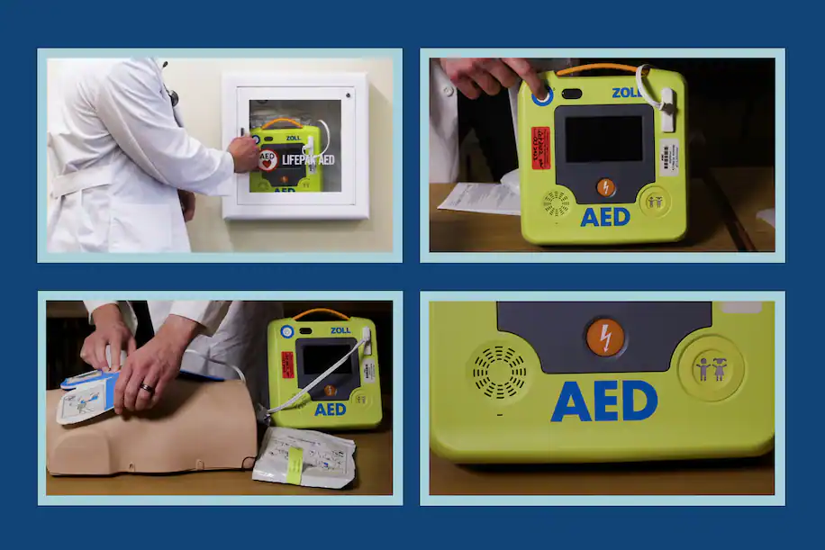

Slide 11
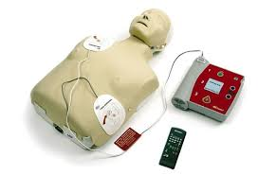
AUTOMATED EXTERNAL DEFRIBILATOR [AED]
?

Slide 12
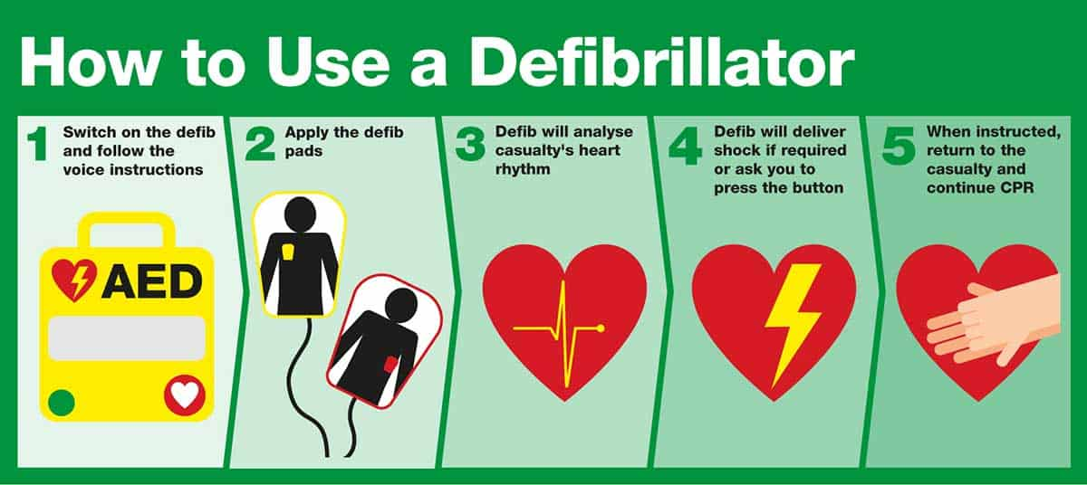

Slide 13
How does an AED work?
The AED uses voice prompts, lights and text to tell the
rescuer the steps to take.
AEDs may have two sets of pads — adult pads and
child pads. For CPR, anyone 1 year or older who hasn’t
gone through puberty is considered a child. However,
for defibrillation, make sure you use the adult pads for
anyone 8 years or older.
Follow these steps when using the AED:
Turn on the AED and follow the voice prompts.
Remove all clothing covering the chest. If necessary,
wipe the chest dry.
Peel away the backing from the pads and attach the
pads to the person’s bare chest following the illustration on the pads.

Slide 14
Plug the pad connector cable into the AED, if necessary
Prepare to let the AED analyze the heart’s rhythm
Make sure no one is touching the person
Say, “CLEAR!” in a loud, commanding voice
Deliver a shock, if the AED determines one is needed
Make sure no one is touching the person
Say, “CLEAR!” in a loud, commanding voice
Push the “shock” button to deliver the shock
After the AED delivers the shock, or if no shock is advised, immediately start CPR, beginning with compressions

Slide 15
THANK YOU

